Slide 1

Computable Functions
Chapter 25

Slide 2
Total and Partial Functions
f is a total function on the domain Domain iff f is defined on all elements of Domain.
f is a partial function on the domain Domain iff f is defined on zero or more elements of Domain.
Let Dom ⊆ Domain be the set of elements on which f is defined, then f is total on Dom.
f: {a,b,c} -> {0,1} g: {a,b,c} -> {0,1}
a 1 a 1
b 0 b 0
c c
In f, Domain = Dom = {a,b,c}, total
In g, Domain = {a,b,c}, Dom={a,b}, partial on Domain, total on Dom
Notes:
Some mathematicians define Dom to be the domain of a function. In that case, all functions are total

Slide 3
Total and Partial Functions
  ● The successor function succ:
  ● Total on Domain = ℕ.
  ● midchar, which returns the middle character of its argument string if there is one.
    ● Partial on Domain = {w} = set of strings.
    ● Total on Dom = {w : |w| is odd for string w}
  ● steps, defined on inputs of the form <M, w>, returns the number of steps that Turing machine M executes, on input w, before it halts.
    ● Partial on Domain = {<M, w>}
    ● Total on Dom = {<M, w>: Turing machine M halts on input w}.
  Why can’t we just narrow Domain to Dom, then all functions become total?

Slide 4
Why Bother to Have Partial Functions
  Look at steps, defined on inputs of the form <M, w>, returns the number of steps that Turing machine M executes, on input w, before it halts.
    Partial on Domain = {<M, w>}
    Total on Dom = {<M, w>: Turing machine M halts on input w}.
  Dom for steps is not in D, i.e., not decidable
    We cannot have a function whose domain is not decidable
    Impossible for any implementation of steps to check its precondition.
    The only way is to define its domain as some decidable set and then allow elements of that domain for which steps will not return a value.
    Thus, steps becomes a partial function.
    Such program will fail to halt on some inputs.
  Now look at midchar, which returns the middle character of its argument string if there is one.
    Partial on Domain = {w} = set of strings.
    Total on Dom = {w : |w| is odd for string w}
  midchar is also partial but Dom for midchar is in D
Notes:
Then for midchar, why define it as partial function?
My understanding: in the case of midchar and similar functions where Dom is decidable, it’s maybe just convenient to define them as partial functions because this way, the domain is easier to specify.

Slide 5
Partially Computable Functions
  Let M = (K, Σ, Γ, δ, s, {h}).
  The initial configuration of M will be (s, w).
  Define M(w) = z iff (s, w) |-_{M}* (h, z).
A function f is partially computable or partial recursive iff there is a Turing machine M_{p} such that for all w ∈ Σ*:
  1. If w is an input on which f is defined, M_{p}(w) = <f(w)>
  (In other words, M_{p} halts with the encoding of f(w) on its tape)
  2. Otherwise, M_{p} does not halt
  (In some references, “ … or it might get stuck at some point, but it must not pretend to produce a value for f at w”)

Slide 6
Computable Functions
  Let M = (K, Σ, Γ, δ, s, {h}).
  The initial configuration of M will be (s, w).
  Define M(w) = z iff (s, w) |-_{M}* (h, z).
A function f is computable or recursive iff there is a Turing machine M_{c} such that for all w ∈ Σ*:
  If w is an input on which f is defined, M_{c}(w) = <f(w)>
  Otherwise, M_{c} halts and output “Error”
M_{c} always halts
Every computable function is also partially computable.
  Because if there exists M_{c} for f, there must exist M_{p} for it.
Not vice versa, unless there’s some additional condition
  Dom of f is decidable (will see later)
Notes:
We can use M_{c} as a subroutine of M_{p}
Seeing “Error”, loop

Slide 7
Computable Total Functions
A function f is computable or recursive iff there is a Turing machine M_{c} such that for all w ∈ Σ*:
  If w is an input on which f is defined, M_{c}(w) = <f(w)>
  Otherwise, M_{c} halts and output “Error”
Note, if f is total, 2 is never reached.
Thus, a function f is computable if it is total and partially computable. Or, a total function f is computable iff it’s partially computable.
Or, for any total function, computable = partially computable.
  e.g., succ (we need to show we can find M_{p} for it, skip here)
  e.g., the characteristic function of a language L (or a set).
  A function f with domain Domain is a characteristic function of a set L iff f(x) = True if x is an element of L and False otherwise.
  Such f must be total coz on any element, in or out of L, f must be define.
  So, a language is decidable iff its characteristic function is computable.
  This doesn’t mean all computable functions needs to be total. see next

Slide 8
Computable Partial Functions
Equivalently, a function f is computable iff f is partially computable and the Dom of f is decidable.
  since f is partially computable, we can find M_{p} for it
  since Dom of f is decidable, we can find a decider M_{d} for it
  Then we can build M_{c} like this:
  (1) Run M_{d} on w (to check precondition)
  (2) If M_{d} rejects (w is undefined), M_{c} halts and output “Error”
  (3) Otherwise (M_{d} accepts and w is undefined), run M_{p} on w
  e.g., midchar is partial but its Dom is decidable (we need to show we can find M_{p} for it, skip here)
For any f, if its Dom is not decidable (like steps, Dom = {<M, w> : M halts on w>}), it cannot be computable. At most partially computable.
  So, for any partial function, computable -> partially computable but not vice versa

Slide 9
Alternatively …
The text first defines “computes”, and then uses it to define “computable” and “partially computable”. I found it less intuitive and more confusing … However, it can be convenient when we say “There is no Turing machine that computes it” …
  Let M = (K, Σ, Γ, δ, s, {h}).
  The initial configuration of M will be (s, w).
  Define M(w) = z iff (s, w) |-_{M}* (h, z).
  M computes a function f iff, for all w ∈ Σ*:
    If w is an input on which f is defined, M(w) = <f(w)>
    Otherwise M(w) does not halt
A function f is partially computable or partial recursive iff there is a Turing machine M that computes it.
  M does not always halt (for w that is undefined)
A function f is computable or recursive iff there is a Turing machine M that computes it and that always halts.
  Equivalently, a function f is computable iff it’s partially computable and its domain is a decidable set.
Note: in some references, computable is used for partially computable

Slide 10
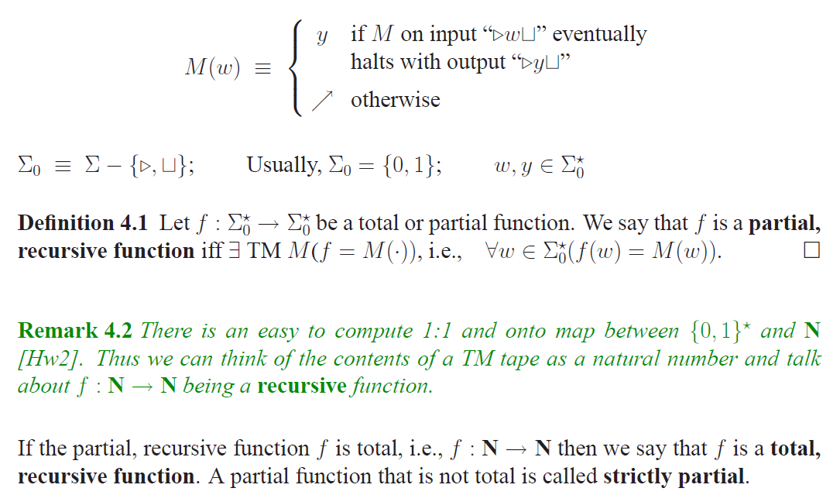
Alternatively …
Notes:
Neil Immerman
Same as my original intuition/plan. Like it, but …

Slide 11
Computing and Deciding
A language is decidable iff its characteristic function is computable.
  In other words, a language L is decidable iff there exists a Turing machine that always halts and that outputs True if its input is in L and False otherwise.
Actually, a language is decidable iff its characteristic function is partially computable.
  Because the function must be total
We might be attempted to say the following:
  A language is semi-decidable iff its characteristic function is partially computable.
This is wrong, but the following is true:
    A language is semi-decidable if its characteristic function is partially computable.
    Because if decidable, then semi-decidable (D is a subset of SD)
  If L is in SD but not D (semidecidable but not decidable), either:
    L does not have a characteristic function
    Its characteristic function is not partially computable

Slide 12
Computing and Deciding
  If L is in SD but not D (semidecidable but not decidable), either:
    L does not have a characteristic function
    Its characteristic function is not partially computable
  But then we can define for L a "partial characteristic function" f, whose Dom = L
    i.e., for only elements in L, f is defined and maps them to 1.
    Then we can say the following:
    A language is semi-decidable iff its partial characteristic function is partially computable.
    Then, we can say the following:
    Deciding or semideciding a language L is also computing the characteristic function or partial characteristic function of L.
  If L is not in SD (not semidecidable), either:
  L does not have a partial characteristic function (what could be the case)
  Its partial characteristic function is not partially computable (next slide ¬SD)
Notes:
but a little problem here. in partially computable, for undefined input M does not halt. In semi-decidable, for element not in L, M either rejects or does not halt. But if we change "computes" a bit, make it "halts or does not halt" for undefined input, ok
People indeed defined partial characteristic functions … interesting

Slide 13
Three Views
The Problem View | The Language View | The Functional View
Given three natural numbers, x, y, and z, is z = x⋅y? | {x ∗ y = z : x, y, z ∈ {0, 1}*, num(x)⋅num(y) = num(z)} D | f : ℕ × ℕ → ℕ, f(x, y) = x⋅y computable
Given a TM M, does M have an even number of states? | {<M> : M has an even number of states} D | f : {<M>} → Boolean, f(<M>) = True if M has an even number of states, False otherwise computable
Given a TM M and a string w, does M halt on w in n steps? | {<M, w, n> : M halts on w in n steps} SD/D | f : {<M, w>} → ℕ, f(<M, w>) = If TM M halts on w, then the number of steps it executes before halting, else undefined. partially computable
Given a TM M, does M halt on all strings in no more than n steps? | {<M, n> : M halts on each element of Σ* in no more than n steps} ¬SD | f :{ <M} → ℕ, f(<M>) = If TM M halts on all strings, then the maximum number of steps it executes before halting, else undefined. not partially computable

Slide 14
Example of Computing a Function
Let Σ = {a, b}. Let f(w) = ww. //duplicating a string
Input: w Output: ww
1. copy:
w → ww
2. shift:
ww → ww

Slide 15
Computing Numeric Functions
Example: succ(n) = n + 1
We will represent n in binary. So n ∈ 0 ∪ 1{0, 1}*
Input: n Output: n+1
1111 Output: 10000
Scan right until the first . Then move on square back left so that the head is on the last digit of n.
Loop:
  If the current digit is 0, write a 1, move head left to the first , and halt
  If the current digit is 1, we need to carry. So write a 0, move one square to the left, and go back to the top of the loop
  If the current digit is , we have carried all the way to the left. Write a 1, move one square to the left, and halt
Notes:
Without leading 0s

Slide 16
There Exist Functions That Are
Not Partially Computable
Theorem: There exist (a very large number of ) functions that are not partially computable.
Proof: By a counting argument. Let U be the set of unary functions from some subset of ℕ to ℕ. Encode both inputs and outputs as binary strings.

Slide 17
There Exist Functions That Are
Not Partially Computable
Lemma: There is a countably infinite number of partially computable
functions in U.
Proof of Upper bound: Every partially computable function in U is computed by some Turing machine M with Σ and Γ equal to {0, 1}, There are countably infinitely many such machines. There cannot be more partially computable functions than there are Turing machines.
Proof of Lower bound: The number of partially computable functions must be infinite because it includes all the constant functions:
cf₁(x) = 1, cf₂(x) = 2, cf₃(x) = 3, …
So there is a countably infinite number of partially computable functions in U.

Slide 18
There Exist Functions That Are
Not Partially Computable
Lemma: There is an uncountably infinite number of functions in U.
Proof of Lemma: Let S be P(ℕ). For any element s of S, let f_{s} be the characteristic function of s. No two elements of S have the same characteristic function. There is an uncountably infinite number of elements in S, so there is an uncountably infinite number of such characteristic functions, each of which is in U.

Slide 19
There Exist Functions That Are
Not Partially Computable
Proof of Theorem: Since there is only a countably
infinite number of partially computable functions in U
and an uncountably infinite number of functions in U,
there is an uncountably infinite number of functions in
U that are not partially computable.

Slide 20
Can We Describe One?
Yes, use diagnolization.
Let E be a lexicographic enumeration of the TMs that compute the partially computable functions in U.
Let M_{i} be the i^{th} machine in that enumeration.
Define a new function notcomp(x) as follows:
notcomp: ℕ → {0, 1},
notcomp(x) = 1 if M_{x}(x) = 0,
0 otherwise.
So notcomp(x) = 0 if either:
• M_{i}(x) is defined and the value is something other than 0, or
• M_{i}(x) is not defined.
This new function notcomp is in U, but it differs, in at least one place, from every function that is computed by a Turing machine whose encoding is listed in E. So there is no Turing machine that computes it. Thus it is not partially computable.

Slide 21
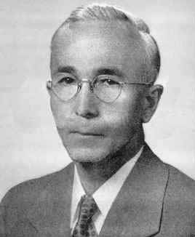
Busy Beaver Functions
There are functions with straightforward definitions that are not partially computable.
Busy beaver functions
Tibor Radó:
Hungarian mathematician
moved to USA after WWI
lectured at Harvard and Rice, before obtaining a faculty position in the Department of Mathematics at Ohio State
In 1962, published his most famous results: The Busy Beaver function and its non-computability
Tibor Radó (1895-1965)

Slide 22
Busy Beaver Functions
Let T be the set of all standard TMs that:
● Have tape alphabet Γ = {, 1}, and
● Halt on a blank tape.
Define the busy beaver functions S(n) and Σ(n):
● S(n): the maximum number of steps that are executed by any element of T with n-nonhalting states, when started on a blank tape, before it halts.
● Σ(n): the maximum number of 1’s that are left on the tape by any element of T with n-nonhalting states, when it halts.
Notes:
In computability theory, a busy beaver (from the colloquial expression for "industrious person") is a Turing machine which, when started on an empty tape, runs as long as possible, but eventually halts. This machine attains the limits on the amount of time and space that a halting Turing machine of the same class can consume.
The busy beaver function quantifies those limits and is an example of a non-computable function. In fact, it can be shown to grow faster than any computable function. The concept was first introduced by Tibor Rado as the "busy beaver game" in his 1962 paper, "On Non-Computable Functions".
…
Radó went on to prove that there is no computable function that bounds Σ(n); that is, for any given computable function f, there must be some n (and thus, one can show, infinitely many n), for which Σ(n) > f(n). Therefore Σ is non-computable.

Slide 23
The Busy Beaver Functions
● S(n): the maximum number of steps.
● Σ(n): the maximum number of 1’s.
n | S(n) | Σ(n)
1 | 1 | 1
2 | 6 | 4
3 | 21 | 6
4 | 107 | 13
5 | ≥ 47,176,870 | 4098
6 | ≥ 3∗10¹⁷³⁰ | ≥ 1.29∗10⁸⁶⁵

Slide 24
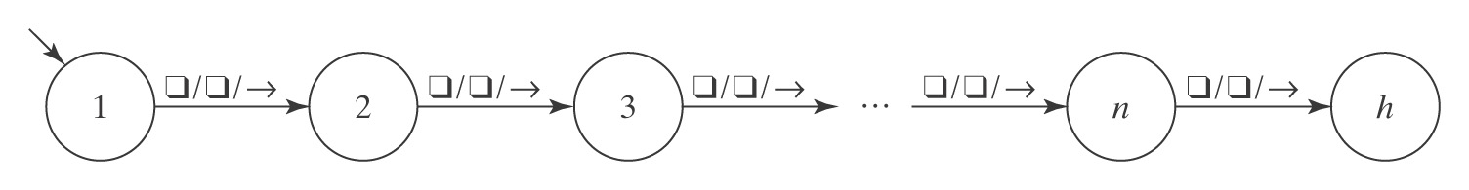
The Busy Beaver Functions are Total
Theorem: Both S and Σ are total functions on the positive
integers.
Proof: For any value n, both S(n) and Σ(n) are defined iff
there exists some standard Turing machine M, with tape
alphabet Γ = {, 1}, where:
● M has n nonhalting states, and
● M halts on a blank tape.
Name the nonhalting states of M with the integers 1, …, n.
Then M is:

Slide 25
Monotonicity
Theorem: Both S and Σ are strictly monotonically increasing functions. In other words:
S(n) < S(m) iff n < m, and
Σ(n) < Σ(m) iff n < m.
Proof: We prove four claims:
n < m → S(n) < S(m).
S(n) < S(m) → n < m.
n < m → Σ(n) < Σ(m).
Σ(n) < Σ(m) → n < m.

Slide 26
Computability
Theorem: Neither S nor Σ is computable.
Proof that S is not computable: If it were, there would be some TM BB, with b states, that computes it. Define:
● For any positive integer n, a Turing machine Write_{n} that writes n 1’s on its tape, one at a time, moving rightwards, and then halts with its read/write head on the blank square immediately to the right of the rightmost 1. Write_{n} has n nonhalting states plus one halting state.
● Multiply, which multiplies two unary numbers, written on its tape and separated by the character #. Let m be the number of states in Multiply.

Slide 27
Computability
Define Trouble_{n}:
>Write_{n} ; R Write_{n} L Multiply L BB
Trouble_{n}:
Writes a string of the form 1^{n};1^{n}.
Moves its read/write head back to the left
Invokes Multiply, which results in the tape containing a string of exactly n² 1’s.
It moves its read/write head back to the left.
Invokes BB, which outputs S(n²).

Slide 28
The Number of States in Trouble_{n}
>Write_{n} ; R Write_{n} L Multiply L BB
Component | Number of States
Write_{n} | n + 1
; R | 1
Write_{n} | n + 1
L | 2
Multiply | m
L | 2
BB | b
Total | 2n + m + b + 7

Slide 29
The Bottom Line
Since BB writes a string of length S(n²) and it can write only one character per step, Trouble_{n} must run for at least S(n²) steps. If n > 0, Trouble_{n} is a TM with 2n + m + b + 7 states that runs for at least S(n²) steps. So:
S(2n + m + b + 7) ≥ S(n²)
S is monotonically increasing, so it must also be true that, for
any n > 0:
2n + m + b + 8 ≥ n²
But, since n² grows faster than n does, that cannot be true.
In assuming that BB exists, we have derived a contradiction.
So BB does not exist. So S is not computable.

Slide 30
Recursive Function Theory
A function is computable iff there is a Turing machine that
computes it and always halts.
Is there an alternative, nonprocedural definition?
The more traditional terminology:
  recursive for decidable
  recursively enumerable for semidecidable
  recursive for computable
  partial recursive for partially computable
Note: in some references, computable and recursive are used for partially computable and partial recursive
Why use recursive as a synonym for computable?
Notes:
==========
The word enumerable is used because the following are equivalent for a nonempty subset B of the natural numbers:
B is the domain of a computable function.
B is the range of a total computable function. If B is infinite then the function can be assumed to be injective.
If a set B is the range of a function f then the function can be viewed as an enumeration of B, because the list f(0), f(1), ... will include every element of B.
The above is from wiki for “computable functions”. But we are talking about A in f:A->B, not B. The above is true for B. f can be considered as an enumeration of B, but we are talking about A …

Slide 31
Primitive Recursive Functions
The set of primitive recursive functions is the smallest set that includes:
  ● The constant function 0.
  ● succ(n) = n + 1.
  ● A family of projection functions: (n₁, n₂, … n_{k}) = n_{j}.
and is closed under:
● Composition of g with h₁, h₂, … h_{k}:
g(h₁( ), h₂( ), … h_{k}( ))
● Primitive recursion of f in terms of g and h:
f(n₁, n₂, …n_{k}, 0) = g(n₁, n₂, …n_{k})
f(n₁, n₂, …n_{k}, m+1) = h(n₁, n₂, …n_{k}, m, f(n₁, n₂,…n_{k}, m))

Slide 32
Examples
plus(n, 0) = p1,1(n) = n.
plus(n, m+1) = succ(p3,3(n, m, plus(n, m))).
For clarity, we will simplify our future definitions by omitting the explicit calls to the projection functions. Doing that here, we get:
plus(n, 0) = n.
plus(n, m+1) = succ(plus(n, m)).

Slide 33
Examples
times(n, 0) = 0.
times(n, m+1) = plus(n, times(n, m)).
factorial(0) = 1.
factorial(n + 1) = times(succ(n), factorial(n)).
exp(n, 0) = 1.
exp(n, m+1) = times(n, exp(n, m)).
pred(0) = 0.
pred(n+1) = n.

Slide 34
Primitive Recursive Functions and Computability
Theorem: Every primitive recursive function is computable.
Proof: Each of the basic functions, as well as the two combining operations can be implemented in a straightforward fashion on a Turing machine or using a standard programming language.

Slide 35
Primitive Recursive Functions and Computability
Theorem: Not all computable functions are primitive recursive.
Proof: Lexicographically enumerate the unary primitive recursive
functions, f₀, f₁, f₂, f₃, ….
Define g(n) = f_{n}(n) + 1. g is computable, but it is not on the list.
Suppose it were f_{m} for some m. Then
f_{m}(m) = f_{m}(m) + 1, which is absurd.
Suppose g were f₃. Then g(3) 27 + 1.
 | 0 | 1 | 2 | 3 | 4
f₀
f₁
f₂
f₃ |  |  |  | 27
f₄

Slide 36
A Function that Isn’t Primitive Recursive
Ackermann’s function:
A(0, y) = y + 1.
A(x + 1, 0) = A(x, 1).
A(x + 1, y + 1) = A(x, A(x + 1, y)).

Slide 37


Ackermann’s Function
 | 0 | 1 | 2 | 3 | 4
0 | 1 | 2 | 3 | 4 | 5
1 | 2 | 3 | 4 | 5 | 6
2 | 3 | 5 | 7 | 9 | 11
3 | 5 | 13 | 29 | 61 | 125
4 | 13 | 65533 | 2⁶⁵⁵³⁶-3 * | #
* 19,729 digits 3⋅10¹⁷ seconds since Big Bang
# 10⁵⁹⁴⁰ digits 10⁷⁹ atoms in observable universe
Thus writing digits at the speed of light on all atoms in the universe starting at the Big Bang would have produced 3⋅10⁹⁶ digits.

Slide 38
Minimalization
The minimalization f of a function g (of k + 1 arguments) is a function of k arguments:
f(n₁,n₂,…n_{k}) = the smallest m such that:
g(n₁, n₂, … n_{k}, m) = 1, if there is such an m,
0, otherwise.
Given any function g and any set of k arguments to it, there either is at least one value m such that
g(n₁, n₂, … n_{k}, m) = 1 or there isn’t.
If there is at least one such value, then there is a smallest one. So there always exists a function f that is the minimalization of g.

Slide 39
Minimalization
If g is computable, then we can build a Turing machine T_{min} that almost computes f as follows:
T_{min}(n₁, n₂, … n_{k}) =
1. m = 0.
2. While g(n₁, n₂, … n_{k}, m) ≠ 1 do:
m = m + 1.
3. Return m.

Slide 40
The Problem with T_{min}
T_{min}(n₁, n₂, … n_{k}) =
1. m = 0.
2. While g(n₁, n₂, … n_{k}, m) ≠ 1 do:
m = m + 1.
3. Return m.
T_{min} will not halt if no value of m exists. There is no way for T_{min} to discover that no such value exists and thus return 0.
A function g is minimalizable iff,
for every n₁, n₂, … n_{k},
there is an m such that g(n₁, n₂, … n_{k}, m) = 1.

Slide 41
Recursive Functions
A function is μ-recursive iff it can be obtained from the
basic functions:
  ● The constant function 0.
  ● succ(n) = n + 1.
  ● A family of projection functions: (n₁, n₂, … n_{k}) = n_{j},
Using the operations of:
  ● Composition,
  ● Recursive definition, and
  ● Minimalization of minimalizable functions.

Slide 42
Primitive Recursive vs μ-Recursive Functions
● Primitive recursive: Use iteration.
● μ-recursive: Use while loop.

Slide 43
Equivalence of μ-Recursion and Computability
Theorem: A function is μ-recursive iff it is computable.
Proof: By two constructions that show that each can
simulate the other:
Every partial μ-recursive function is partially computable. We show this by showing how to build a Turing machine for each of the basic functions and for each of the combining operations.
Every partially computable function is partial μ-recursive. We show this by showing how to construct μ-recursive functions to perform each of the operations that a Turing machine can perform.

Slide 44
Partial μ-Recursive Functions
A function is partial μ-recursive iff it can be obtained from
the basic functions:
● the constant function 0,
● the successor function: succ(n) = n + 1,
● the family of projection functions: for any k ≥ j > 0,
p_{k,j}(n₁, n₂, … n_{k}) = n_{j},
and that is closed under the operations:
● composition of g with h₁, h₂, … h_{k}.,
● primitive recursion of f in terms of g and h, and
● minimalization (of any, possibly nonminimalizable
function).

Slide 45
Equivalence of Partial μ-Recursion and Partial Computability
Theorem: A function is partial μ-recursive iff it is
partially computable.
Proof: By two constructions that show that each can
simulate the other.

Slide 46
Functions and Machines
Partial Recursive
Functions
Recursive
Functions
Primitive Recursive
Functions
Turing Machines

